Slide 1
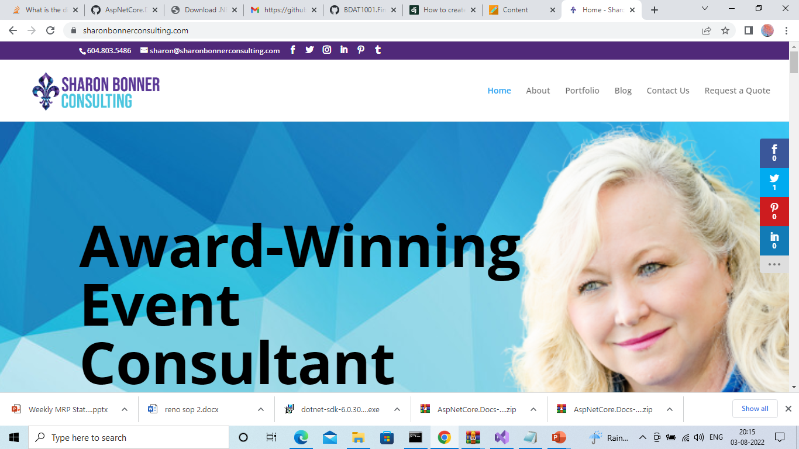


Analytics Analyst
Project Code:GEO 1327
Mary Lijo Cletus
Akshay Vijayan
Arshad Rafeek Shemi
Big Data Analytics – BDAT1011

Slide 2
Team Profile
Akshay Vijayan
Arshad Rafeek Shemi
Mary Lijo Cletus
Developer
Business Analyst
Data Analyst
Data analysis and data visualization
Managing proper communication between client and the team,
Data analysis
Managing cleaning and developing solutions from data
Development and testing

Slide 3
Website Analysis
As part of Analytics analyst project we have analyzed Sharon Bonner Consultancy company website.
https://sharonbonnerconsulting.com

Slide 4
Major Observations
Great Website Content
Vlogs in the website is also meaningful and good
Portfolio Section in the website is also good

Slide 5
Findings after Analysis
Images provided in the website are oversized as a result the clarity of the images are affected
Loading time of the website is more.
The overall view of the website is a combination of blue and lavender same as in the logo which can be made more attractive

Slide 6
Suggestions
If the size of the images are compressed properly and then uploaded into the website, then the image quality will increase at the same time the speed of the website will also improve as it reduces the loading time

Slide 7
Thank you

